Slide 1
Anomaly Detection in Grids Explainability
Early March-2021

Slide 2
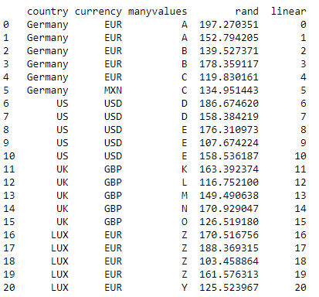
Explainability Example 1
Column with little value. Might help to predict country. Somewhat correlated with ‘manyvalues’
Predictable error
Random column to confuse. Shouldn’t help us at all or be predictable.
Predictable error

